Slide 1
Ken Okoye
COFSP Recipient
Senior, Biomedical Engineering
9th Grade Biology, Loveland HS

Slide 2
Learning Standards
This unit covers Medical Technology
NGSS
  Asking questions and defining problems
  Engaging Argument from evidence
  Cause and Effect
  Obtaining, evaluating and communicating information
ONLS
  Designing Technology/Solutions Using Science concepts
  Interpreting and Communicating Science Concepts
CCSS
  Reasoning abstractly and quantitatively
  Construct viable argument and critique the reasoning of others

Slide 3
Materials Selection of a Medical Device
Objectives:
Identify Material Properties and how they meet device needs.
Guiding Questions:
How do you select the type of material to go into a medical device?

Slide 4
ACS
Application: The type of thought process directly affects the outcome of patients that use/require these devices
Career Awareness: This activity explores the tasks of a biomedical engineer. The lecture makes students aware of the consequences for engineering
Societal Impact: Overall materials selection of medical devices improves healthcare and improves quality of life

Slide 5
Student Learning

Slide 6
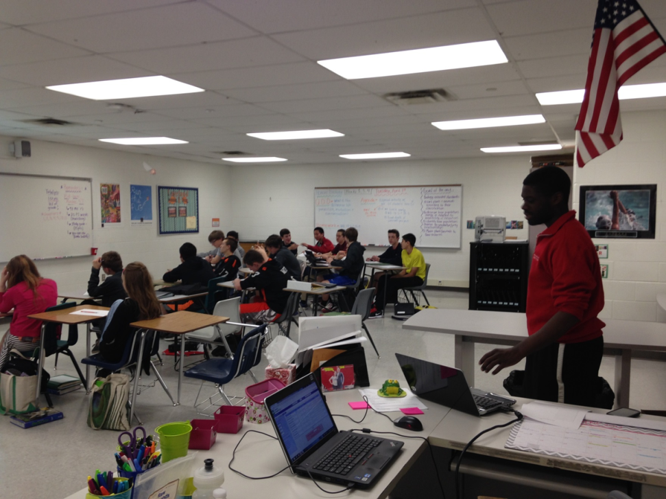
Activity Implementation
Day One
  Administer Pre-test
  Present Hook
  Deliver lecture
  Present challenge
  Assign groups / devices
  Students work on Challenge
Day Two
  Continue Working on Challenge/ presentations
  Groups present findings
  Administer Post-test

Slide 7
Reflections
Having done the activity, I would have broken up the activity worksheets into more steps to guide their thought processes. I maybe would have found additional resources to which to direct them.

